Slide 1



Impact of Firm Characteristics on Management Quality in Sweden: An Econometric Analysis
JEL classification: L10, M11, M14, M19
By Hannah Saethereng, Westminster University
12/12/2023

Slide 2
Introduction
Theory and mechanism
Human Capital Theory (degrees)
Leadership Theories (seniority)
Organizational Culture Theory (reliability)
Competition and Exportation
Reflect external pressures and market dynamics
Importance and Significance
Practical Implication for firms
Which factors significantly impact the quality of management
Decision-Making Insights
Make informed decisions about workforce composition
Strategic Planning
Identifying key areas that need attention
Notes:
Theory:
The theoretical framework in your regression analysis can draw from various management and organizational theories, as well as economic and business theories. Here are a few examples:
Human Capital Theory:
Application: Variables like "degree_m," "degree_nm," and "degree_t" can be linked to the Human Capital Theory, suggesting that the educational composition of the workforce may impact the overall quality of management.
Leadership Theories:
Application: "i_seniority" may be related to leadership theories, indicating that the seniority of managers within a company could influence management quality.
Organizational Culture Theory:
Application: Variables such as "reliability" might be connected to organizational culture theory, as reliability measures could be indicative of certain cultural aspects within the organization.
Underlying Mechanism:
Understanding the underlying mechanisms involves discerning how these variables interact to influence the dependent variable, which is "management" in this context:
Educational Composition:
Mechanism: The percentage of managers and non-managers with a college degree, as well as the overall workforce with a college degree, might influence the collective knowledge and problem-solving capabilities within the organization, impacting management quality.
Managerial Seniority:
Mechanism: Managerial seniority could affect the level of experience and familiarity with company operations, potentially influencing how well management functions.
Reliability Measure:
Mechanism: The reliability measure, calculated from "i_knowledge" and "i_willingness" scores, could reflect the consistency and dependability of managers, potentially impacting management quality.
Competition and Exportation:
Mechanism: Variables like "competition" and "export" might reflect external pressures and market dynamics, influencing strategic decisions made by management.
Practical Implications:
The results can have practical implications for firms, offering insights into which factors significantly impact the quality of management.
Decision-Making Insights:
Organizations can use the findings to make informed decisions about workforce composition, managerial seniority, and other factors to enhance management quality.
Strategic Planning:
The regression can contribute to strategic planning by identifying key areas that need attention to optimize management practices.

Slide 3
Litterateur review
“What Factors Affect Management Quality? State Infrastructure Management and the Government Performance Project,” by Jimenez, Benedict S and Pagano, Michael A (2012)
Divided legislature, legislative term limits, and less strict tax and expenditure limits (TELs) are correlated with higher infrastructure management quality
Urbanization has a positive but marginal impact on infrastructure management quality.
Notes:
The results of the exploratory empirical model suggest that divided legislatures, legislative term limits, less restrictive TELs, and urbanization are all positively correlated with higher GPP grades for capital management. While this research has contributed to our knowledge of inf
In summary, the study suggests that factors such as political variables, fiscal institutions, fiscal condition, and the organizational environment play complex roles in determining the quality of infrastructure management in U.S. states. The presence of a divided legislature, legislative term limits, and less stringent TELs are associated with higher infrastructure management grades. Urbanization also has a positive but relatively marginal impact on infrastructure management quality.

Slide 4
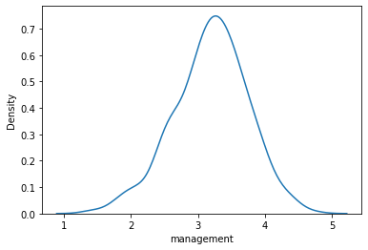
Data and Visualization
WMS-management-survey data on manufacturing companies from 24 countries, collected between 2004 and 2015. I have only looked at data from Sweden.
The distribution of how management quality look normal symmetric
Mean is 3.18
There are 404 observations

Slide 5


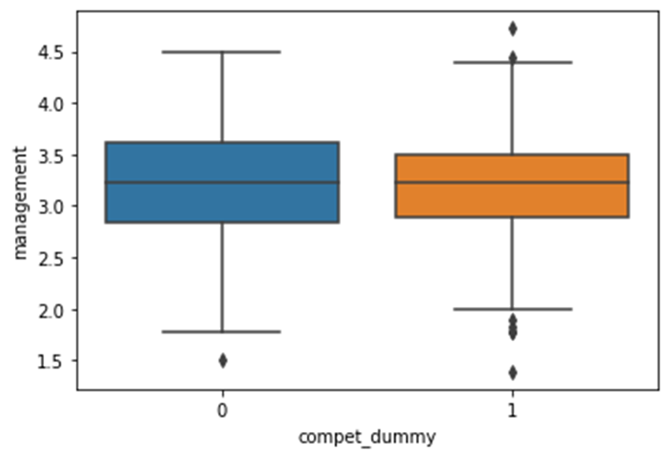
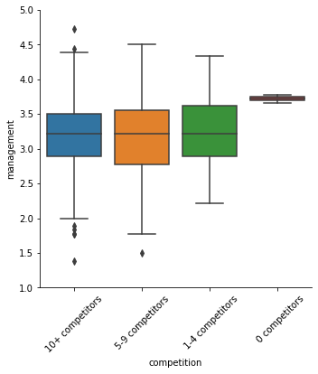
Data and Visualization (Competition)
Distribution of management quality among competitors
0 means less than 10 competitors
1 means high competition (more than 10)
Notes:
This is a box plot that visualize the distribution of management quality among competitors. There was only 2 firms with 0 competitors that is why the box is very small.

Slide 6
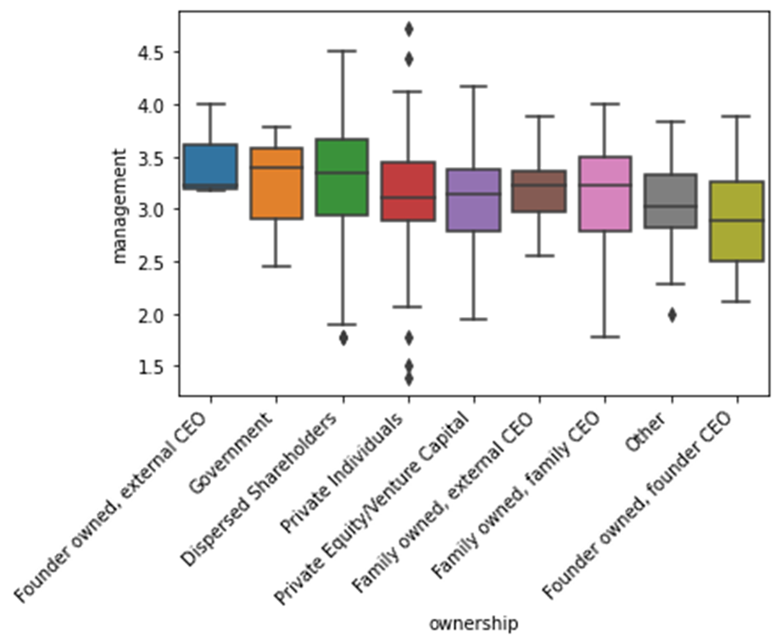
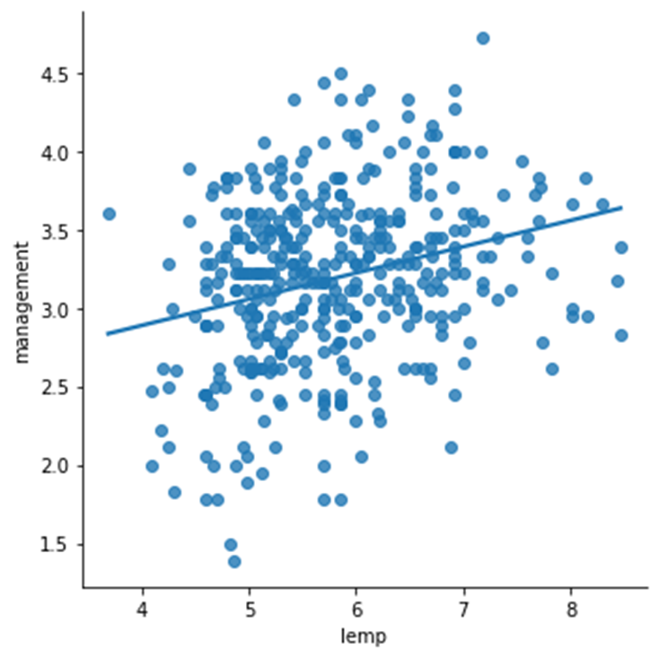
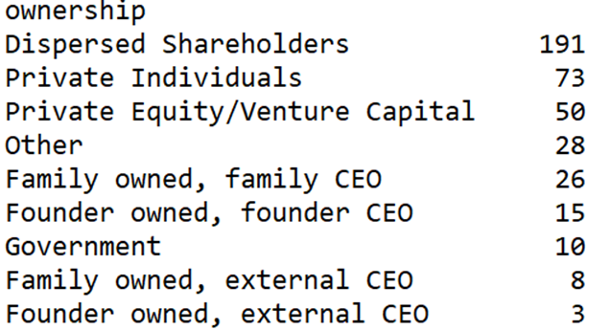
Data and Visualization (ownership and size)
Ownership type effect on management quality
Size of the firm's effect on management quality
Notes:
This is a box plot that visualize the distribution of management quality among competitors. There was only 2 firms with 0 competitors that is why the box is very small.

Slide 7
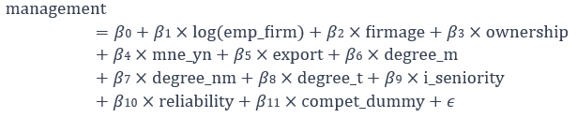
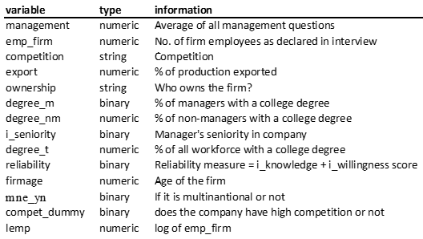
The econometric model and estimation method
Econometric Model
Estimation Method
OLS Linear Regression Model
Limitations and Assumptions
Homoskedasticity
Independence of Errors
Linearity
Normally distributed Residuals
Notes:
Dependent variable management
Independent variables: all the other
The estimation method used is Ordinary Least Squares (OLS). OLS minimizes the sum of squared differences between the observed values of the dependent variable and the values predicted by the model.
​,β2​,β5​,β6​,β7​,β8​,β9​: These coefficients represent the marginal effects of the natural logarithm of firm employees, firm age, export percentage, and educational variables on the average management score, holding other variables constant.
β3​,β4​,β10​,β11​: These coefficients represent the impact of ownership, multinational status, reliability, and high competition on the average management score.
Limitations and Assumptions:
Homoskedasticity: The model assumes constant variance of residuals. Heteroskedasticity may violate this assumption.
Independence of Errors: The model assumes that errors are independent. Serial correlation could be a potential issue.
Linearity: The model assumes a linear relationship between the independent and dependent variables.
Normality of Residuals: The model assumes normally distributed residuals.

Slide 8
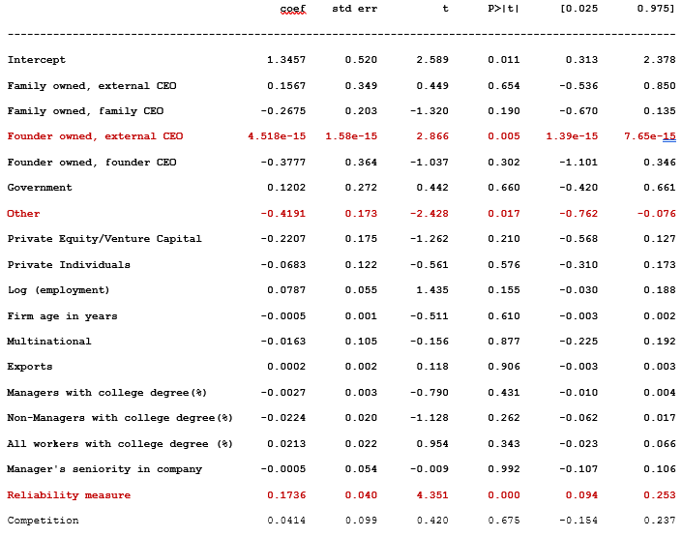
Results
3 significant variables
Most variables are negative
Notes:
-Family owned, External CEO has only 8 observations

Slide 9
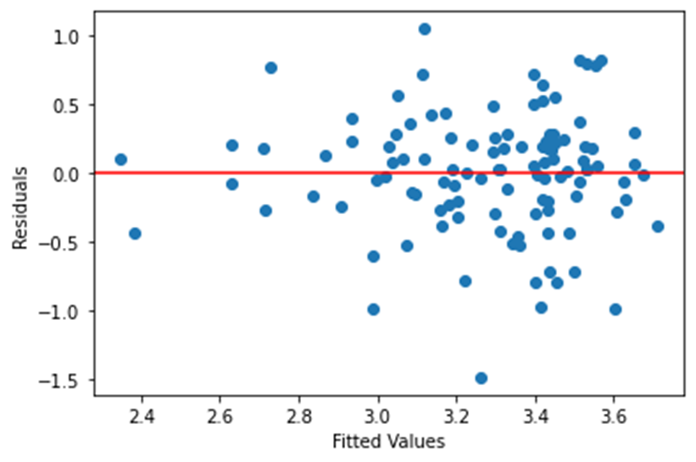
Testing for heteroskedasticity
No clear evidence of heteroskedasticity in the plot
High p-value, we do not reject homoskedasticity in both tests
Notes:
h

Slide 10
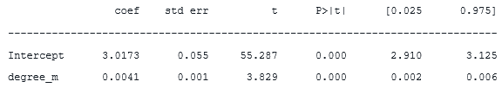
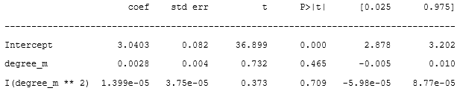
Checking for a quadratic relationship
reg1=smf.ols(formula="management~degree_m",data=df).fit()
reg2=smf.ols(formula="management~degree_m+I(degree_m**2)",data=df).fit()
The percent of management with a college degree is not a quadratic relationship
Could look at firm age instead

Slide 11
Conclusion
What effects the management quality in Sweden?
Findings:
Three significant variables: “Founder Owner, External CEO”, “Other Ownership Types”, “Reliability measure”
Based on my finding I think we should do more research with a larger sample to find out if there are other significant variables. Also look at why Dispersed Shareholders are superior to so many other ownership types.

